Slide 1


CMR TECHNICAL CAMPUS UGC AUTONOMOUS Accredited by NBA & NAAC with ‘A’ Grade Approved by AICTE, New Delhi and JNTU, Hyderabad Kandlakoya(V), Medchal Road, Hyderabad-501401, Telangana Department of Computer Science and Engineering A DATA MINING BASED MODEL FOR DETECTION OF FRAUDULENT BEHAVIOUR IN WATER CONSUMPTION
BATCH NO : 05
Mugala Yeshwanth Reddy 207R1A05A1
Vangala Shruthi 207R1A05B7
Sunkara Nikhil 207R1A05A6
Under the Guidance of
Dr.B.Laxmaiah
(Associate Professor)

Slide 2
CONTENTS
Abstract
Introduction
Existing system
Disadvantages of existing system
Proposed system
Advantages of proposed system
Hardware and software requirements
Novelty
Architecture
Modules
UML Diagrams
Conclusion

Slide 3
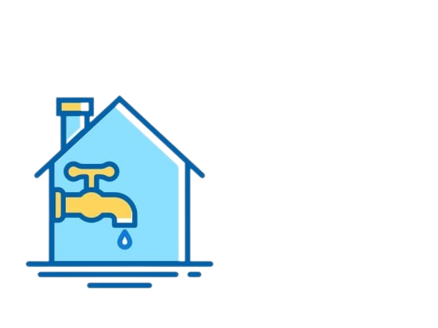

ABSTRACT
Fraudulent behavior in drinking water consumption causes a significant loss of income for water supplying companies. This study uses SVM and KNN classification techniques to detect suspicious fraud water customers. The main motivation of this research is to assist Yarmouk Water Company (YWC) in Irbid city of Jordan to overcome its profit loss. The SVM based approach uses customer load profile attributes to expose abnormal behavior that is known to be correlated with non-technical loss activities. The data has been collected from the historical data of the company billing system. The accuracy of the generated model hit a rate of over 74% which is better than the current manual prediction procedures taken by the YWC. To deploy the model, a decision tool has been built using the generated model. The system will help the company to predict suspicious water customers to be inspected on site.

Slide 4

INTRODUCTION
Water is a scarce resource, and it is essential to manage it efficiently to meet the growing demands of the population. One of the critical challenges faced by water management authorities is the detection of fraudulent behavior in water consumption. Fraudulent activities such as meter tampering, illegal connections, and water theft not only cause revenue losses but also result in wastage of water resources.
Traditional methods of detecting fraudulent behavior in water consumption involve manual inspections, which are time-consuming and prone to errors. In recent years, data mining techniques have emerged as a powerful tool for detecting anomalies in large datasets, making it possible to identify fraudulent behavior in water consumption patterns.

Slide 5
EXISTING SYSTEM
Literature has abundant research for Non-Technical Loss (NTL) in electricity fraud detection, but rare researches have been conducted for the water consumption sector.
Fraudulent behavior in water consumption results in significant financial losses for water supplying companies.
Unlike electricity fraud, there is limited research on fraud detection in the water consumption sector.
Fraudulent customers tamper with water meter readings to avoid or reduce billing amounts.
Two types of water loss exist: technical loss (related to production) and non-technical loss (resulting in revenue loss).
The Jordan Ministry of Water and Irrigation aims to improve services by restructuring and rehabilitating networks, reducing non-revenue water rates, providing new sources, and maximizing resource use.
The Ministry is also working to regulate water usage and detect water loss.

Slide 6
DisadvantageS of Existing System
Relies mainly on manual inspection and analysis of water usage data Time-consuming, costly, and prone to errors May not be able to detect complex fraud schemes or patterns involving multiple users or properties May not be able to adapt to changes in water usage patterns over time May lack the ability to provide real-time alerts or notifications to the appropriate authorities or stakeholders Delays in detecting and addressing fraudulent behaviour may occur as a result of these limitations.

Slide 7
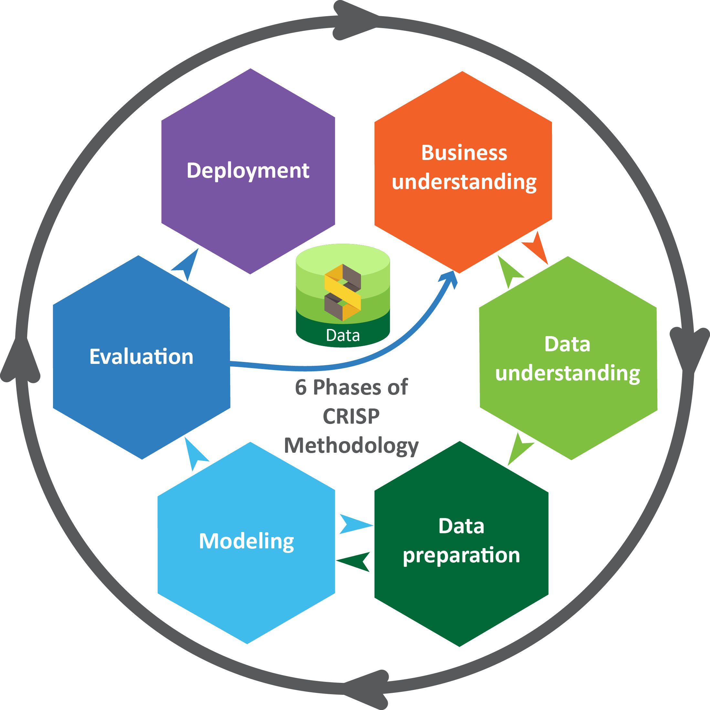
Proposed system
This project uses historical data from the YWC billing system to detect fraudulent customers based on their water consumption using data mining techniques like SVM and KNN. The research follows the CRISP-DM methodology, which includes business understanding, data understanding, data preparation, model building, model evaluation, and model deployment. The data is filtered through preprocessing operations like eliminating redundancy and customers with zero or null consumption values. The final consolidated table contains customer ID, consumption profile, and fraud class attributes, with "YES" for fraud customers and "NO" for normal customers. The original dataset was reduced to 16114 records for non-fraud customers and 647 records for fraud customers.

Slide 8
Advantages of proposed system
More accurate and effective detection of fraudulent behaviour Ability to handle large and complex datasets Faster detection of fraudulent behaviour, potentially in real-time Improved ability to adapt to changes in water usage patterns over time Better identification of patterns and anomalies that may indicate fraudulent behaviour Reduced reliance on manual inspection and analysis Potentially lower costs and fewer errors compared to the existing system Ability to generate automated alerts or notifications for timely response

Slide 9

Requirements specification
Hardware requirements :
Processor: Pentium IV or higher
RAM: 256 MB
Space on Hard Disk: 40 GB
Software requirements :
Python
Django
MySQL
Wamp server

Slide 10
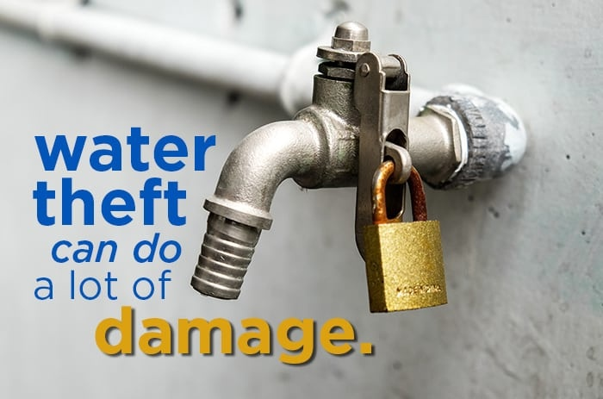
NOVELTY
Use of data mining techniques to detect fraudulent behavior in water consumption patterns
Detection of multiple types of fraudulent behavior, such as meter tampering, illegal connections, and water theft
Real-time detection system that monitors water consumption patterns continuously and alerts authorities if any fraudulent activity is detected
Potential to significantly reduce the time taken to detect fraudulent behavior and prevent losses
Contribution to the sustainable management of water resources by reducing water wastage, preventing leakages, and ensuring equitable distribution of water resources

Slide 11
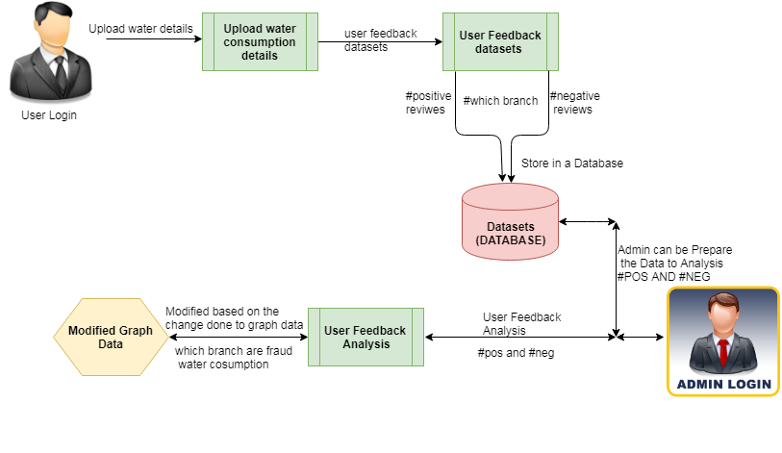
ARCHITECTURE

Slide 12
LIST OF MODULES
USER
ADMIN

Slide 13
MODULES
USER
User Registration
User login
Water Analysis
User Feedback
Logout
ADMIN
Admin Login
Verify User Feedback
User info
Analysis graph
Logout

Slide 14
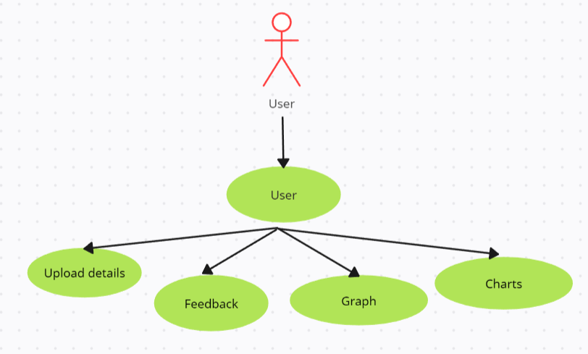
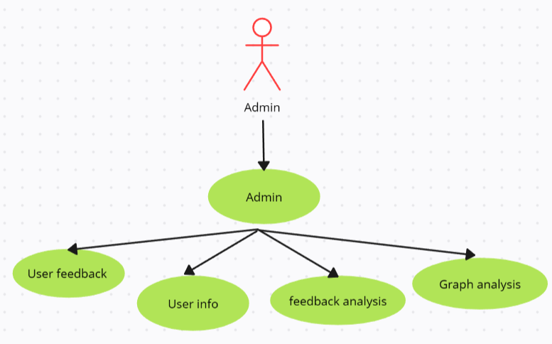
UML DIAGRAMS
USE CASE DIAGRAM
a. User b. Admin

Slide 15
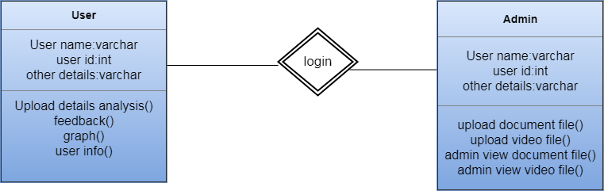
UML DIAGRAMS
CLASS DIAGRAM

Slide 16
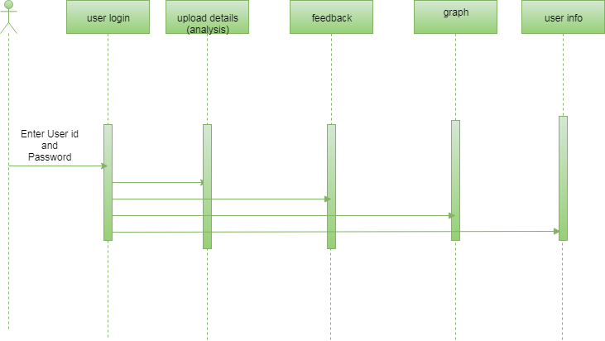
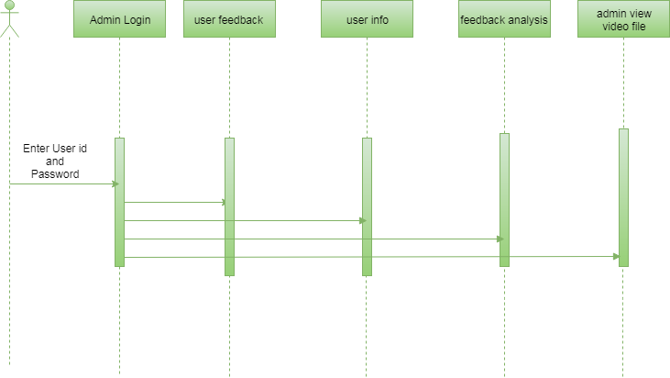
UML DIAGRAMS
SEQUENCE DIAGRAM
a. User b. Admin
X
X
X
X
X
X
X
X
X
X
X
X

Slide 17
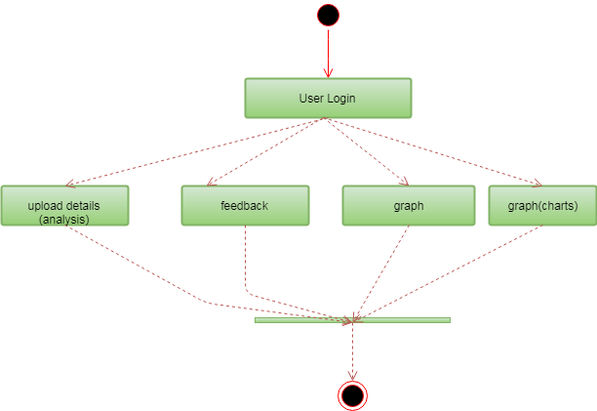
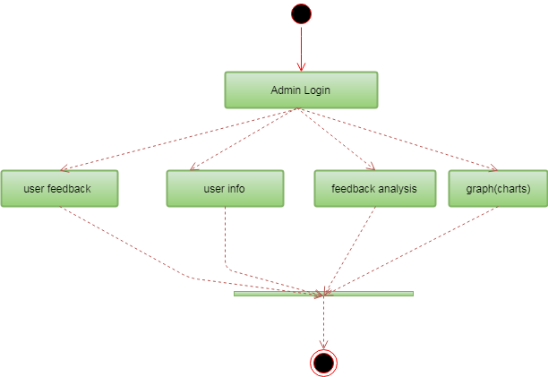
UML DIAGRAMS
ACTIVITY DIAGRAM
a. User b. Admin

Slide 18
COnclusion
In this research, we applied the data mining classification techniques for the purpose of detecting customers, with fraud behavior in water consumption. We used SVM and KNN classifiers to build classification models for detecting suspicious fraud customers. The models were built using the customers’ historical metered consumption data; the Cross Industry Standard Process for Data Mining (CRISP-DM). The data used in this research study the data was collected from Yarmouk Water Company (YWC) for Qasabat Irbid ROU customers, the data covers five years customers’ water consumptions with 1.5 million customer historical records for 90 thousand customers. This phase took a considerable effort and time to pre-process and format the data to fit the SVM and KNN data mining classifiers.

Slide 19


